Slide 1

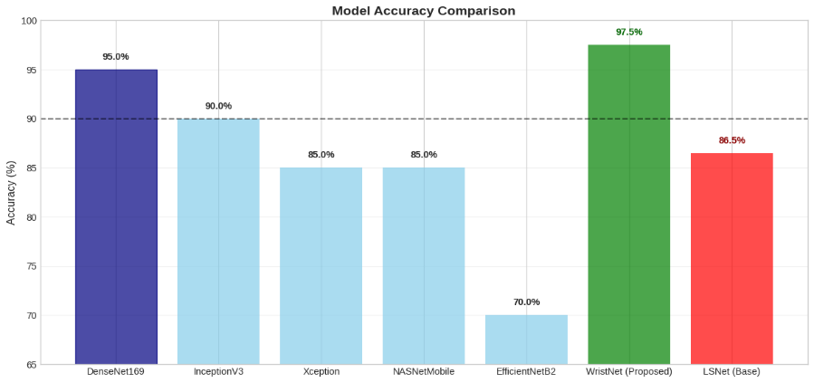
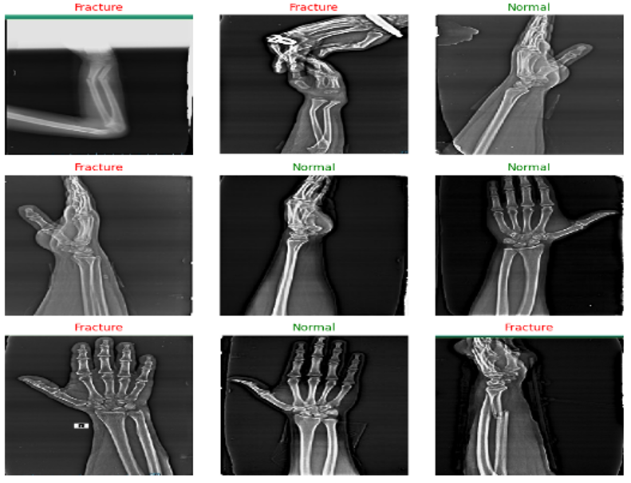
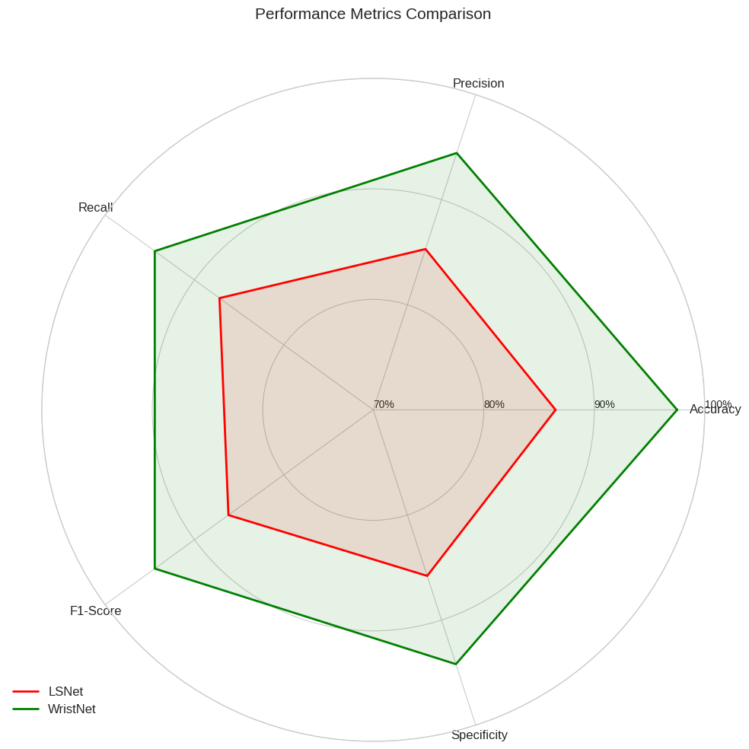
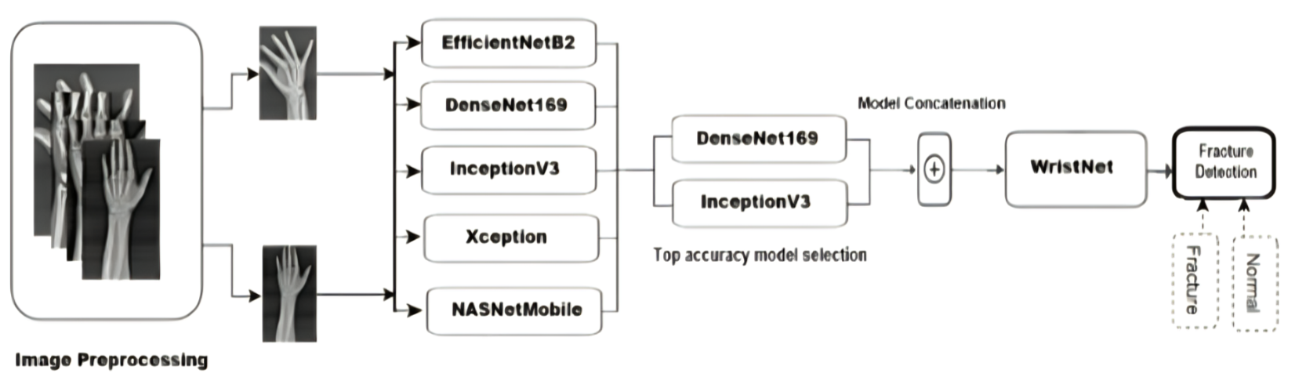
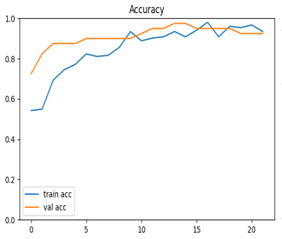
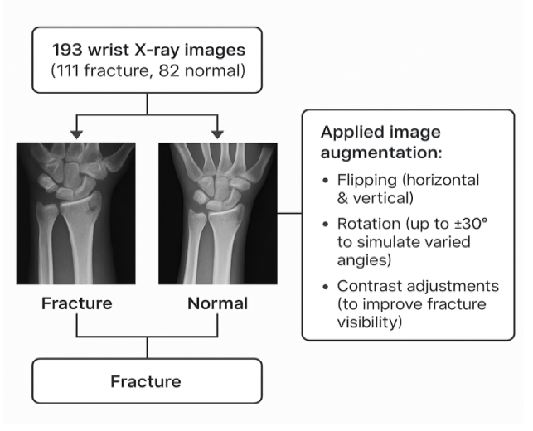
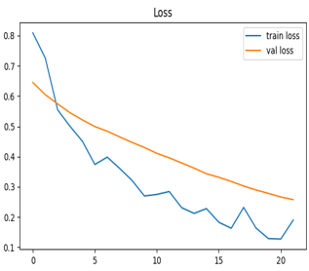
Enhancing wrist fracture detection in wrist x-ray images using deep learning models
Using Feature Concatenation to Enhance Deep Learning for Wrist Fracture Detection
MD. MOSTOFA HASIB (21-44938-2), AHMED FARHAN AMIN (21-44804-1), ALIF HOSSAIN TALHA (21-44923-2), NOKIBUL ARFIN SIAM (21-44793-1)
Introduction
Wrist fractures are very common injuries, often caused by falling on an outstretched hand, and usually involve broken bones in the wrist. It’s important to detect them early to avoid long-term problems, but reading X-rays can be difficult and depends a lot on the doctor’s experience. To help with this, we created WristNet, a deep learning model that combines features from several powerful image recognition models (InceptionV3 and DenseNet169) to better detect wrist fractures. Our aim is to make WristNet a helpful tool for doctors to spot fractures more quickly and accurately.
All Model Accuracy chart
WristNet | 97.50%
Densenet169 | 95.00%
InceptionV3 | 90.00%
Xception | 85.00%
NASNetMobile | 85.00%
EfficientNetB2 | 70.00%
All Model Accuracy Chart
Figure: Dataset and Preprocessing
Methods
Data: Used small-scale labeled wrist X-ray dataset with preprocessing and augmentation.
Models: Trained five CNN models – EfficientNetB2, DenseNet169, InceptionV3, Xception, and NASNetMobile.
Concatenation : Combined high-performing models using feature concatenation to enhance learning.
WristNet: Built a fused deep-learning model by integrating selected models into a single architecture.
Training: The final model to optimize wrist fracture detection performance.
Figure: Prediction Samples
Results
WristNet demonstrated the highest true positive rate.
EfficientNetB2 showed the highest false negative rate
InceptionV3 and DenseNet169 provided balanced performance.
Model | Accuracy | Precision | Recall | F1-Score
WristNet | 97.50% | 94.44% | 99.00% | 99.62%
DenseNet169 | 95.00% | 96.8% | 98.1% | 97.4%
InceptionV3 | 90.00% | 91.7% | 93.2% | 92.4%
Xception | 85.00% | 84.3% | 85.6% | 84.9%
NASNetMobile | 85.00% | 83.9% | 86.2% | 85.0%
EfficientNetB2 | 70.00% | 68.5% | 71.2% | 69.8%
Figure: Performance Metric Comparison
Conclusion
WristNet, an ensemble of DenseNet169 and InceptionV3, achieved 97.50% accuracy, surpassing LSNet by 11%. Using attention-based feature fusion and weighted concatenation, it improves fracture detection and clinical efficiency.
This work reflects my contribution to advancing deep learning in medical imaging, with the goal of improving diagnostic accuracy and efficiency in clinical practice.
Research Methodology Overview
Table : Performance of Individual Deep Learning Models
Data Analysis
Used a balanced wrist X-ray dataset (Normal vs. Fracture) with an 80/20 train/validation split. Applied data augmentation (rotation, shifts, shear, zoom, brightness, flipping) to enhance robustness. Trained models with hyperparameter optimization and validated with cross-validation, achieving strong performance in fracture detection across all metrics.
References
Anwar et al. (2023). LSNet: a novel CNN architecture to identify wrist fracture from a small X‑ray dataset.
Dibo et al. (2023). DeepLOC: Deep Learning-based Bone Pathology Localization and Classification in Wrist X-ray Images.
Thian et al. (2020). Convolutional Neural Networks for Automated Fracture Detection and Localization on Wrist Radiographs.
Shobayo et al. (2022). Fracture Detection in Wrist X-ray Images Using Deep Learning-Based Object Detection Models.
Rashid et al. (2023). A Minority Class Balanced Approach Using the DCNN-LSTM Method to Detect Human Wrist Fracture.
Figure: Validation & Training Accuracy
Acknowledgement
We express our sincere gratitude to the Department of Computer Science, Faculty of Science and Technology, AIUB, for their continuous support and guidance throughout this research. Special thanks to our supervisor and the academic panel for their valuable feedback and mentorship.
Figure: Dataset and Preprocessing
Figure: Validation & Training Loss
Department of Computer Science, Faculty of Science and Technology.
American International University-Bangladesh (AIUB)

